Slide 1
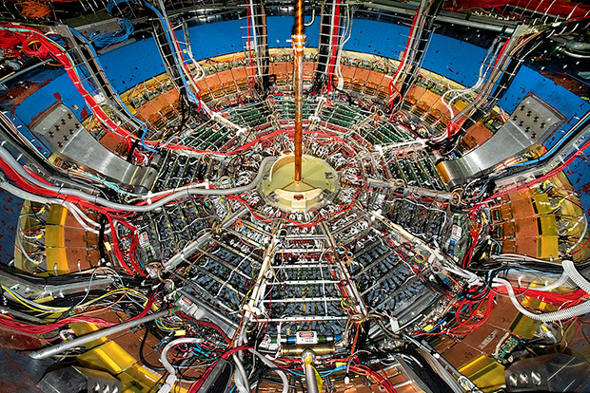
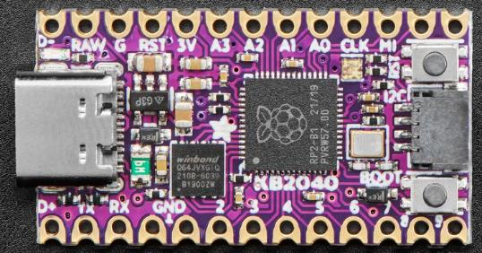
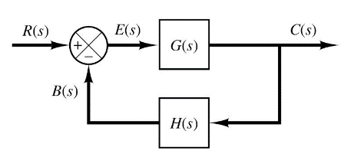

Control Systems
Engineering
(CSE 201)
Student #1
Student #2
Student #3
Team 03
Differential Equations
Simple Harmonic Motion

Slide 2
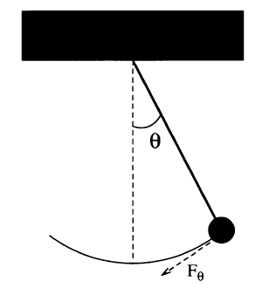
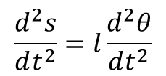






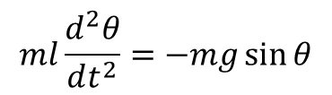

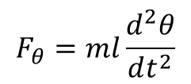

Our Challenge: Model a Pendulum
A “Simple” Pendulum
Gravity is a restoring force
$$F_{θ}=−mg\sin{θ}$$
$$l$$
length of rod (constant)
$$ml\frac{d^{2}θ}{dt^{2}}=−mg\sin{θ}$$
But Euler’s Method works only on first order ODEs! ☹
$$\frac{d^{2}θ}{dt^{2}}=−\frac{g}{l}\sin{θ}$$
$$s=0$$
$$s=lθ$$
$$F=ma$$
$$\frac{dω}{dt}=−\frac{g}{l}\sin{θ}$$
Take 2nd derivative of both sides with respect to time
We can break the 2nd order ODE into two linked first-order ODEs and use Euler’s method on each
$$F=m\frac{d^{2}s}{dt^{2}}$$
$$\frac{dθ}{dt}=ω$$
$$\frac{d^{2}s}{dt^{2}}=l\frac{d^{2}θ}{dt^{2}}$$
$$F_{θ}=ml\frac{d^{2}θ}{dt^{2}}$$

Slide 3
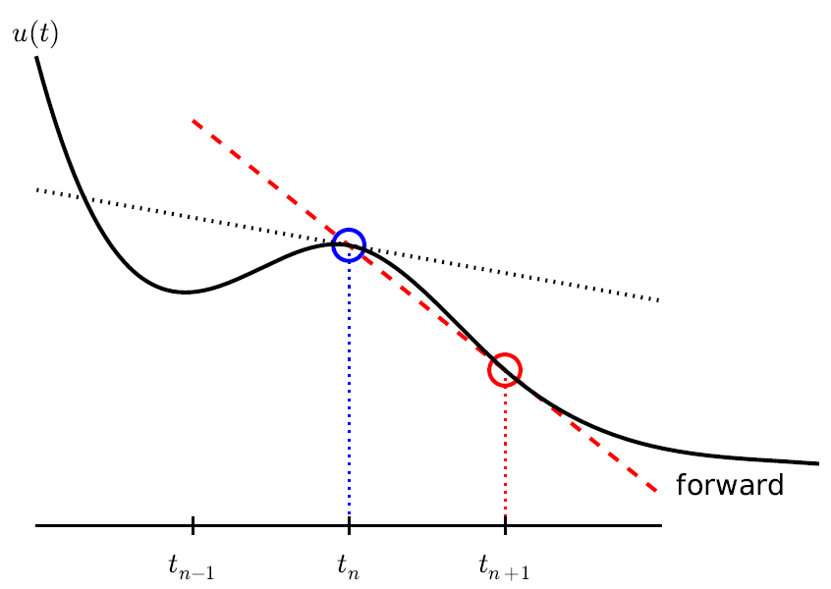




Euler’s Method
$$\frac{dω}{dt}=−\frac{g}{l}\sin{θ}$$
$$ω_{i+1}=ω_{i}−\frac{g}{l}\sin{θ_{i}}Δt$$
$$l$$
$$\frac{dθ}{dt}=ω$$
$$θ_{i+1}=θ_{i}+ω_{i}Δt$$
This is Euler’s Method
in time…

Slide 4
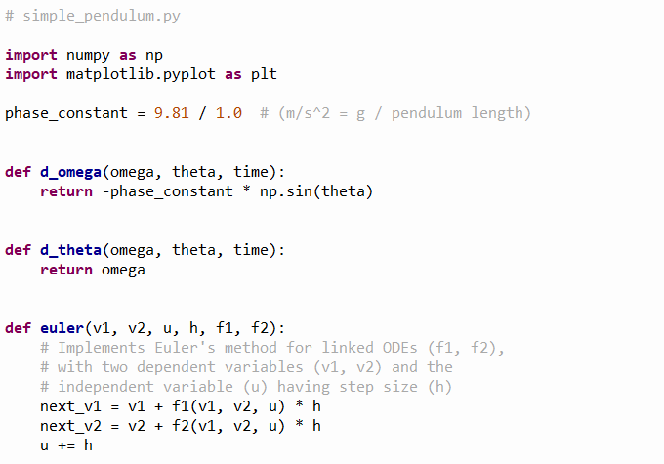


Our Initial Solution
①
②
$$\frac{dω}{dt}=−\frac{g}{l}\sin{θ}$$
③
④
$$\frac{dθ}{dt}=ω$$
⑤
⑥
⑦
⑧
⑨

Slide 5
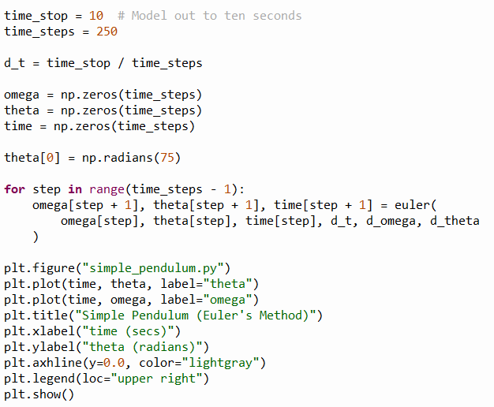
Our Initial Solution
①
②
③
④
⑤
⑥
⑦
⑧
⑨

Slide 6
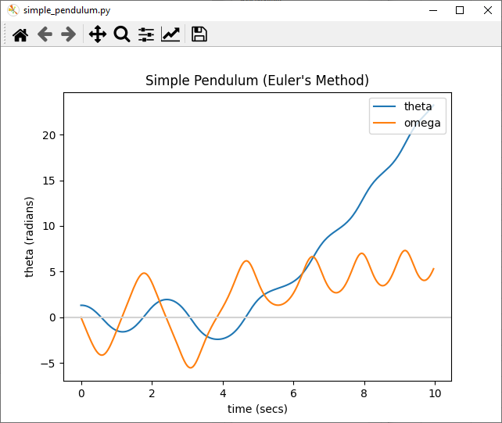

Our Initial Result
Initial pendulum angular displacement from centerline
$$θ_{0}=1.309 rad$$
This is not good… The model predicts the pendulum will begin to swing wildly, which would not happen naturally!

Slide 7

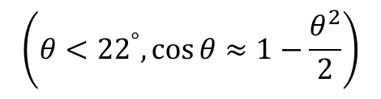


Numerical Instability of Euler's Method For Oscillatory Modes
kinetic
potential
Increasing time_steps by 10x does not prevent the displacement from growing after each oscillation
The simple forward Euler method can be unstable for harmonic motion
The energy in the system is artificially growing over time without bounds because no term can be negative
$$E=\frac{1}{2}ml^{2}ω^{2}+mgl(1−\cos{θ})$$
$$\left(θ<{22}^{°},\cos{θ}≈1−\frac{θ^{2}}{2}\right)$$
Small angle identity
$$E=\frac{1}{2}ml^{2}\left(ω^{2}+\frac{g}{l}θ^{2}\right)$$
$$E_{i+1}=E_{i}+\frac{1}{2}mgl^{2}\left(ω_{i}^{2}+\frac{g}{l}θ_{i}^{2}\right){\left(Δt\right)}^{2}$$
Due to the squaring of values,
the next energy state will always be incorrectly larger than the previous energy state

Slide 8
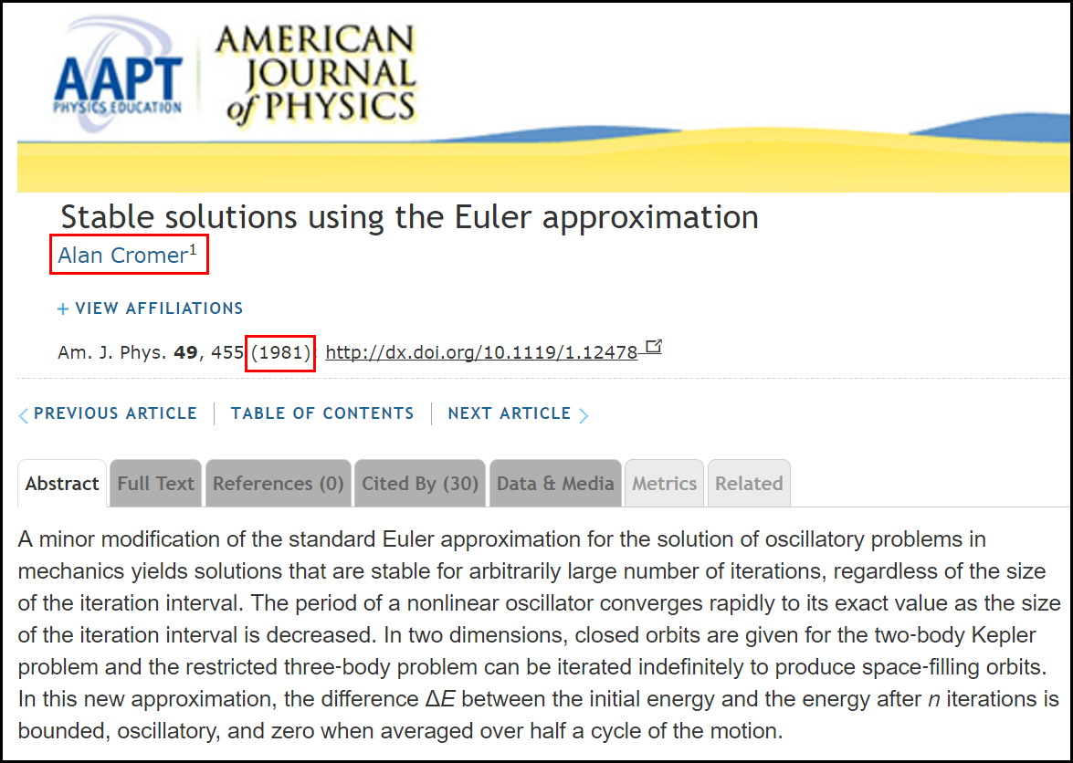
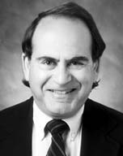
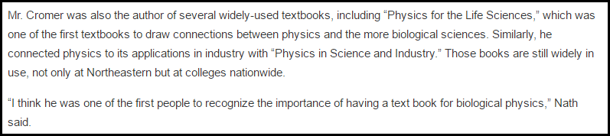
Cromer's Fix to Euler's Method

Slide 9
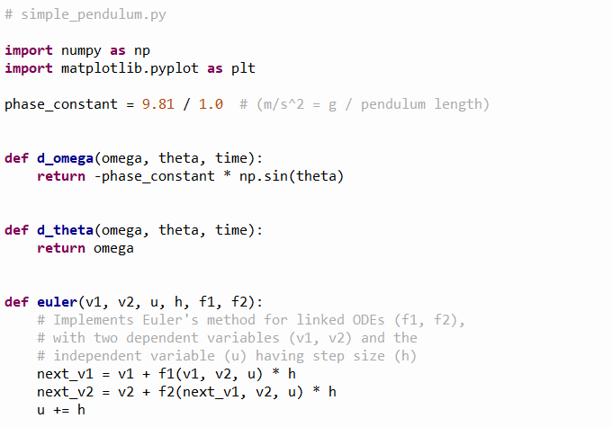
Our Revised Solution
$$\frac{dω}{dt}=−\frac{g}{l}\sin{θ}$$
$$\frac{dθ}{dt}=ω$$
Notice that the original ODEs don't change, just how we calculate them!
①

Slide 10
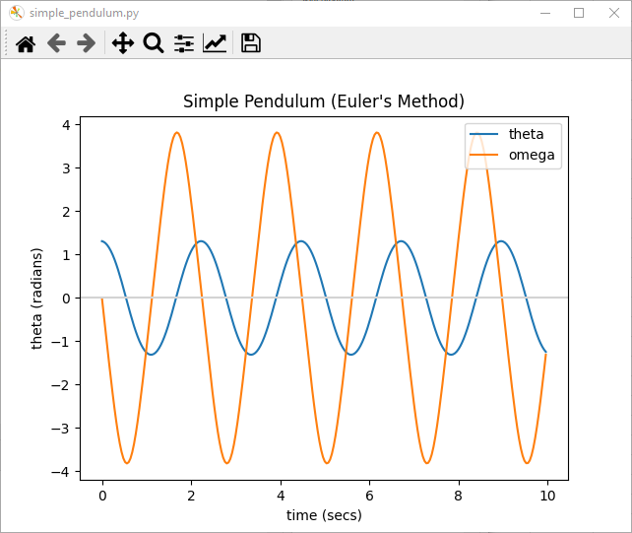
Our Revised Result
This simulation is now numerically stable
The pendulum has maximum velocity when at zero displacement

Slide 11
Most of Science is Waves
Biology
Chemistry
Physics
Math
Electrical
Magnetic
Acoustic
Heat Flow
Vibrational
Torsional
Nuclear / Quantum
Gravitational
Oceanic / Tidal
Orbital Precession
Springs
Pendulums
Tomography
Stock Market
Economics
Astronomical
Fluid Dynamics
Earthquakes
AC / DC
AM / FM
Speech
Heartbeats
It is important that to develop a keen
understanding of the mathematics of waves!

Slide 12

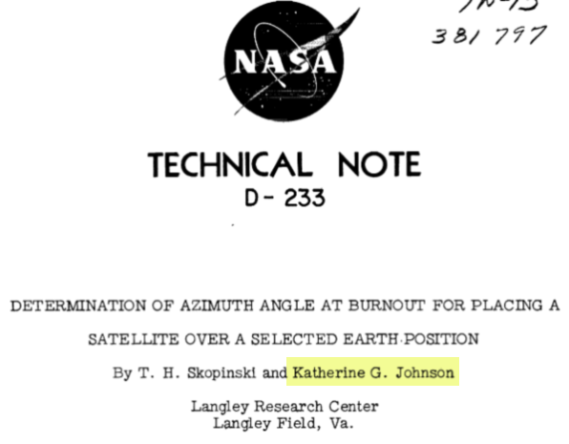
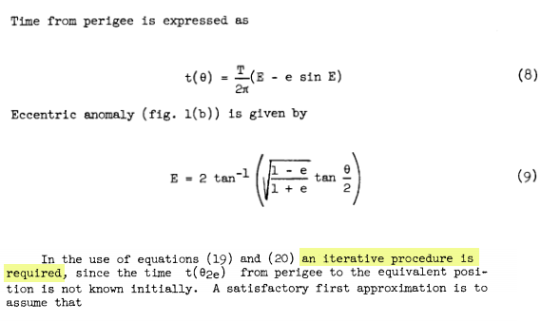
Hidden Figures, Fox 2000 Pictures, 2016
Euler’s Method

Slide 13
Team 03 – What We Learned
How to model a simple pendulum by separating a 2nd order differential equation into a set of linked 1st order differential equations
How to numerically estimate a system of ODEs using Euler’s Forward Method
How to reduce numerical instability by using Cromer’s fix for Euler’s Method
In simple harmonic motion, a point in time having zero displacement represents the point in space where the system has maximum kinetic energy

